Slide 1
Views, Stored Procedures & Transactions

Slide 2
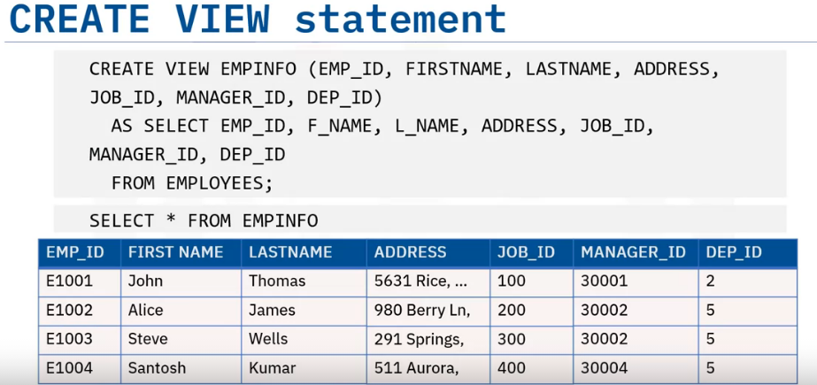
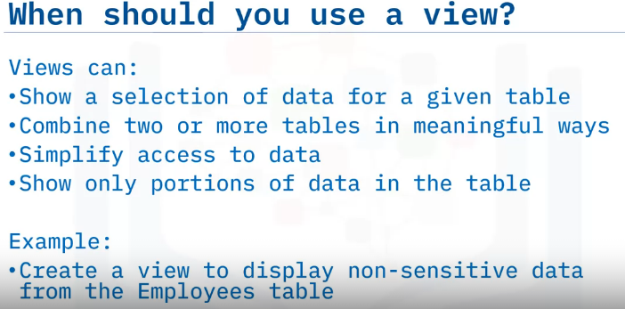
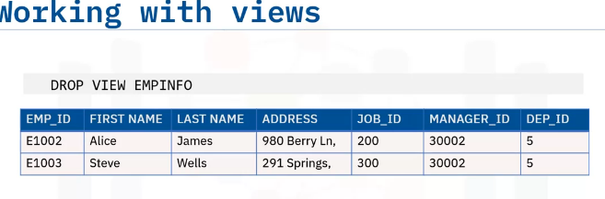
Views
A view is an alternative way of representing data that exists in one or more tables or views.
A view can include all or some of the columns from one or more base tables or existing views.
Once created ,can be queried like a table.
Only definition of the view is stored , not the data.
Non sensitive data: employee ID, name, address, job ID, manager ID, and department ID

Slide 3
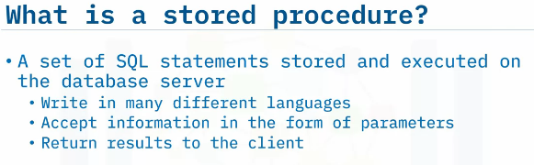
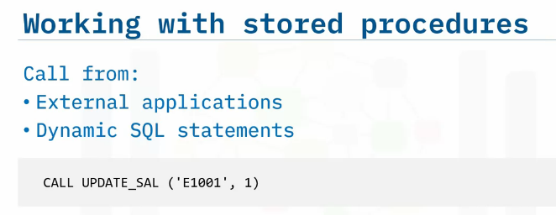
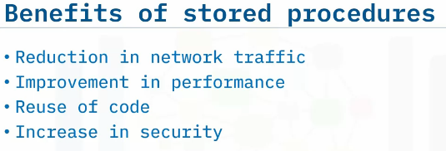
Stored Procedure

Slide 4
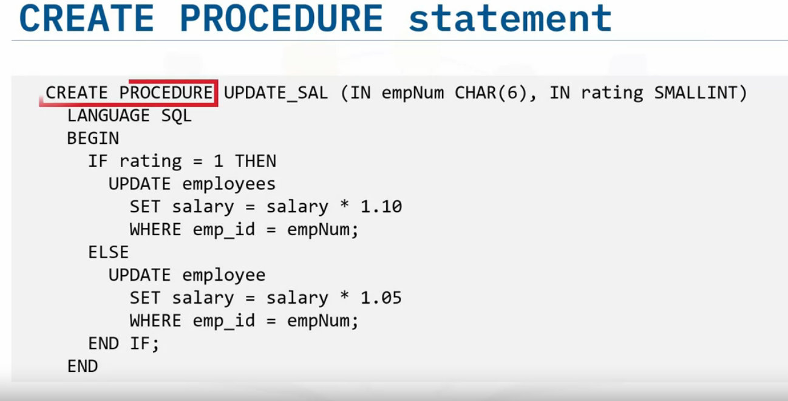
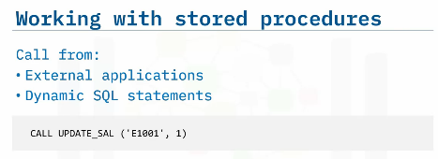

Slide 5
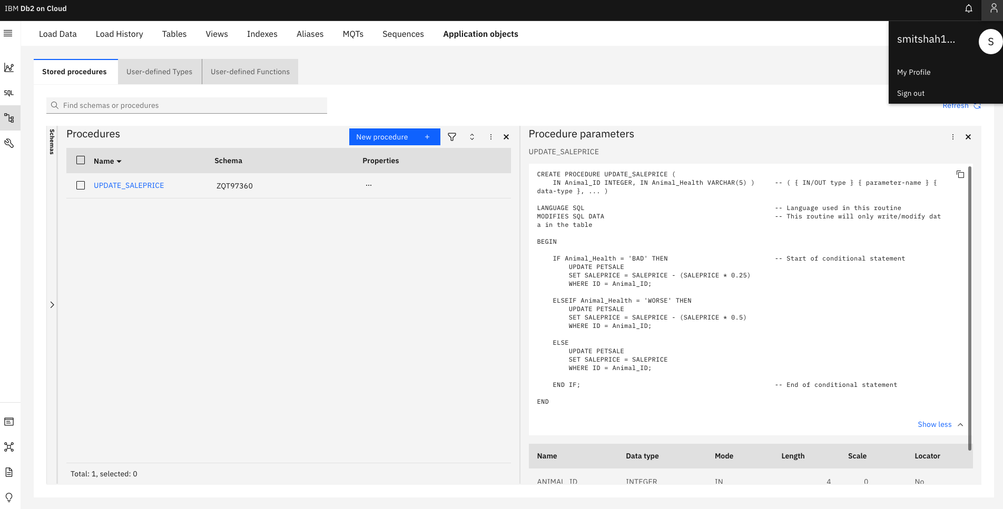

Slide 6
ACID Transactions

Slide 7
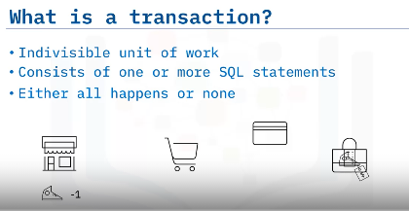
For example, if you make a purchase using your bank card, many things must happen:
The product must be added to your cart
Your payment must be processed - Your account must be debited the correct amount and the store's account credited
The inventory for that product must be reduced by the number purchased

Slide 8
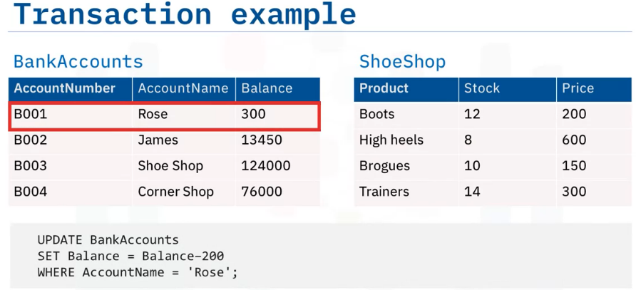
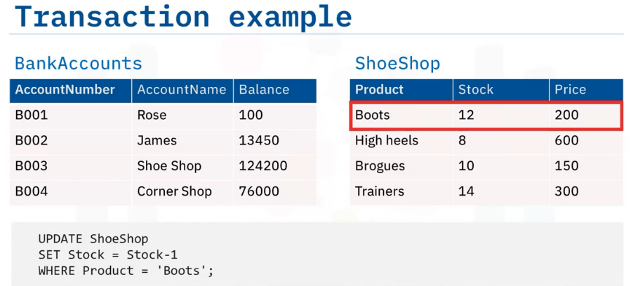
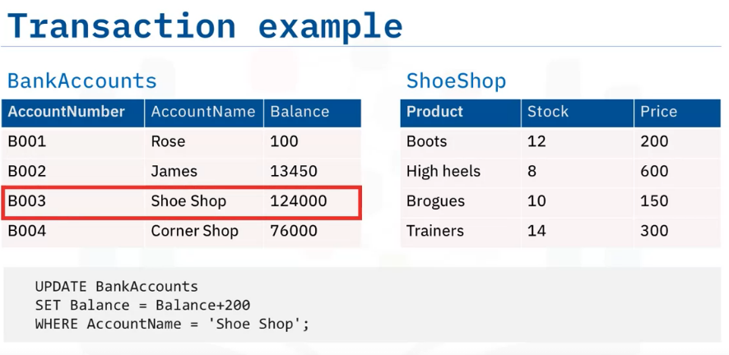
T1
T3
Update statement 1 to decrease account balance
Update statement 3 to decrease shoe stock level
T2
If any of these UPDATE statement fail ,
the whole transaction must fail.
Update statement 2 to Increase account balance

Slide 9
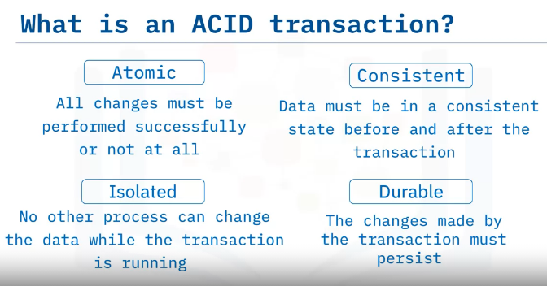

Slide 10
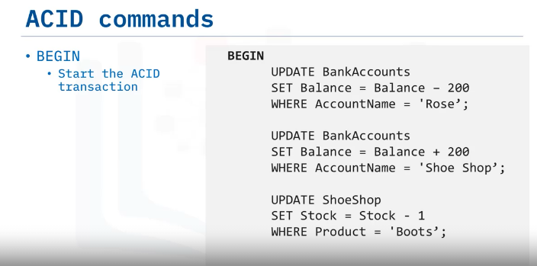
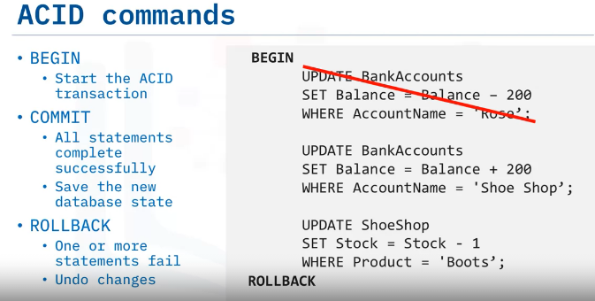
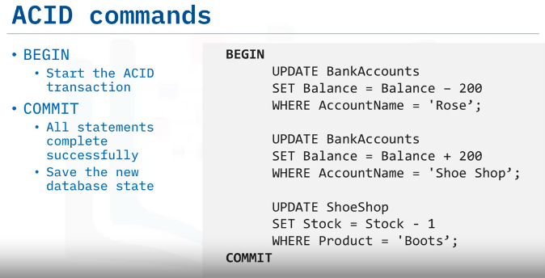

Slide 11
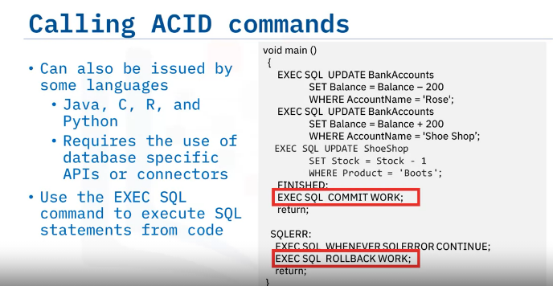
SQL statements can be called from languages like Java, C, R, and Python.
This requires the use of database-specific access APIs such as Java Database Connectivity (JDBC) for Java or a specific database connector like ibm_db for Python.
Most languages use the EXEC SQL commands to initiate a SQL command, including COMMIT and ROLLBACK, as you can see in this example.
Remember that BEGIN is implicit, you do not need to call it out explicitly.
Incorporating SQL commands into your application code gives you the opportunity to create error-checking routines that in turn control whether the transaction is committed or rolled back.

Slide 12
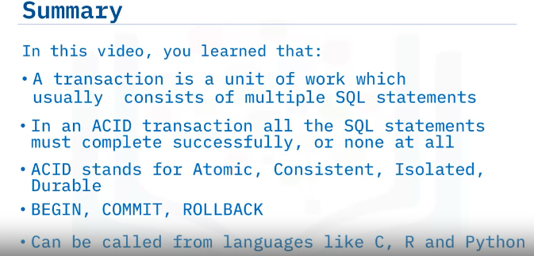
ACID Transaction

Slide 13
--#SET TERMINATOR @
CREATE OR REPLACE PROCEDURE UPDATE_LEADERS_SCORE (IN IN_SCHOOL_ID INTEGER,IN IN_LEADER_SCORE INTEGER)
LANGUAGE SQL
MODIFIES SQL DATA
DYNAMIC RESULT SETS 1_0
BEGIN
UPDATE CHICAGO_PUBLIC_SCHOOLS
SET LEADERS_SCORE = IN_LEADER_SCORE
WHERE SCHOOL_ID = IN_SCHOOL_ID;
IF IN_LEADER_SCORE > 0 AND IN_LEADER_SCORE < 20 THEN
UPDATE CHICAGO_PUBLIC_SCHOOLS
SET LEADERS_ICON='VERY WEAK'
WHERE SCHOOL_ID = IN_SCHOOL_ID;
ELSEIF IN_LEADER_SCORE < 40 THEN
UPDATE CHICAGO_PUBLIC_SCHOOLS
SET LEADERS_ICON='WEAK'
WHERE SCHOOL_ID = IN_SCHOOL_ID;
ELSEIF IN_LEADER_SCORE < 60 THEN
UPDATE CHICAGO_PUBLIC_SCHOOLS
SET LEADERS_ICON='AVERAGE'
WHERE SCHOOL_ID = IN_SCHOOL_ID;
ELSEIF IN_LEADER_SCORE < 80 THEN
UPDATE CHICAGO_PUBLIC_SCHOOLS
SET LEADERS_ICON='STRONG'
WHERE SCHOOL_ID = IN_SCHOOL_ID;
ELSEIF IN_LEADER_SCORE < 100 THEN
UPDATE CHICAGO_PUBLIC_SCHOOLS
SET LEADERS_ICON='VERY STRONG'
WHERE SCHOOL_ID = IN_SCHOOL_ID;
END IF;
END
@
--update the Leaders_Score field in the CHICAGO_PUBLIC_SCHOOLS table for the school identified by in_School_ID to the value in the IN_LEADER_SCORE parameter.

